Slide 1

Introduction to
Algorithms
Xue Qi | Sonia

Slide 2
Table of Content
1
2
What is Algorithm?
What makes a Good Algorithm?
3
4
Basic Search Algorithms
Q&A

Slide 3
What is Algorithm?
1

Slide 4
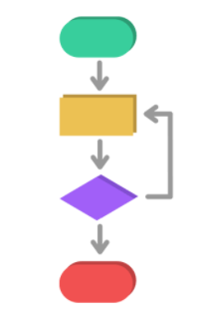
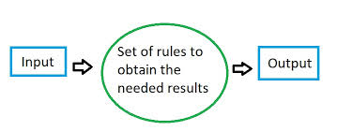
What is Algorithm?
In Mathematics and Computer Science,
Algorithm is…
A set of step-by-step instructions for solving problems

Slide 5
Examples of Algorithms
How does Live Video-Streaming platforms (eg. YouTube) transmit live video across the Internet so quickly?
Audio and Video Compression Algorithms
How does Google Map figure the way back to your house from NYP?
Routing Algorithms
How does Pixar color a 3D model based on lighting of visual room?
Rendering Algorithms

Slide 6
What makes a Good Algorithm?
2

Slide 7




Good Algorithm
Correctness
Efficiency
Whether the right result is obtained for all possible problem instances
Measure of time and computer resources needed to successfully carry out the algorithm

Slide 8


Correctness VS Efficiency
100%
=
Perfect
Algorithm
Take too much Time
Sometimes, we can live with an algorithm that does not give us the correct answer or best answer for a problem
Notes:
Sometimes, we can live with an algorithm that does not give us the correct answer or the best answer for a problem
The only Perfect algorithms that we know for the problem takes a really long time to solve

Slide 9
Basic Search Algorithms
3

Slide 10

Search Algorithms
Process of Search Algorithms
Finding an item within a sequence using a search key to identify the specific item
Types of Search Algorithms
i. Sequential Search (or Linear Search)
Unsorted List
Sorted List
ii. Binary Search

Slide 11
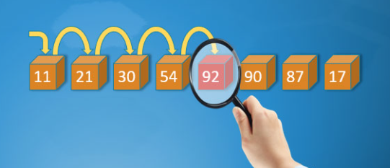
Search Algorithms: Sequential Search
What is Sequential Search?
Can be used on sorted or unsorted
For a successful search of n records
best time is 1 comparison
worst time is n comparison
Notes:
Sequential Search can be used on sorted or unsorted lists. For successful search of n records, best time is 1 comparison and worst time is n comparison, but we will not go in further with it since this is just an introduction.

Slide 12

Search Algorithms: Sequential Search
How does Sequential Search Algorithm work?
Starting from the first item in the list, compare it against the target value
If
a match is found, return position in the list containing the value target
Else
Move to next item in the list and repeat comparison
Notes:
A more detailed explanation of Sequential search is that it is basically the comparison of each item in a list of value against a target value (search key)
Whereby the search terminates when match is found or when the list is exhausted, meaning search key is not found. How does it work?

Slide 13
Search Algorithms: Sequential Search
Example: searching for number 9
11 | 4 | 5 | 9 | 2 | 17 | 24
11 | 4 | 5 | 9 | 2 | 17 | 24
Start off with the first number

Slide 14
Search Algorithms: Sequential Search
Example: searching for number 9
11 | 4 | 5 | 9 | 2 | 17 | 24
9 is not found, move on to the second number
11 | 4 | 5 | 9 | 2 | 17 | 24
9 is not found, move on to the next number

Slide 15
Search Algorithms: Sequential Search
Example: searching for number 9
11 | 4 | 5 | 9 | 2 | 17 | 24
Next number found is 9 !!

Slide 16
Let’s Code! :]
This is where you section ends. Duplicate this set of slides as many times you need to go over all your sections.

Slide 17
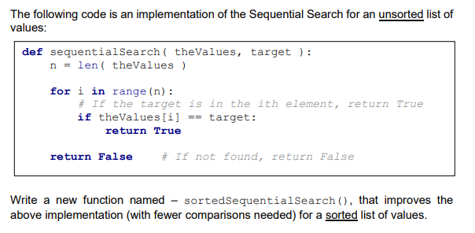
Search Algorithms: Sequential Search

Slide 18
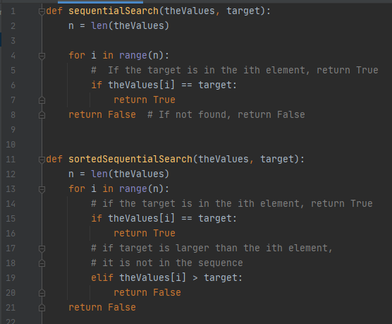
Search Algorithms: Sequential Search Solution

Slide 19
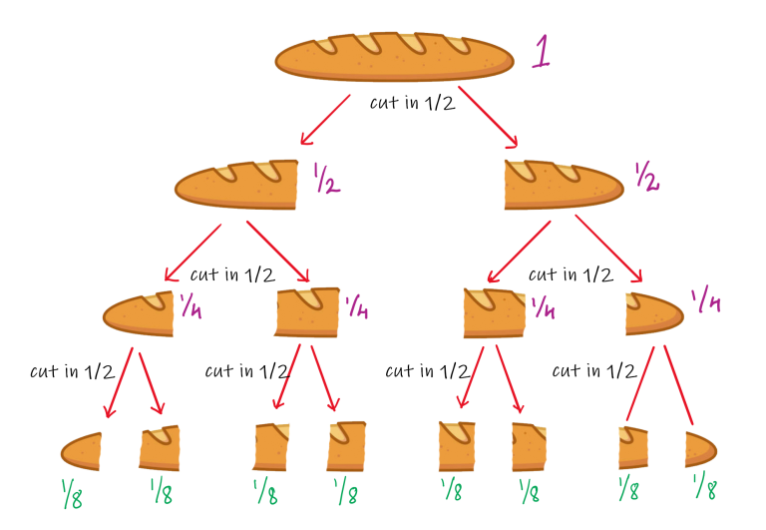
Search Algorithms: Binary Search
What is Binary Search?
Used when list is sorted
More EFFICIENT than Sequential Search
Adopts the Divide and Conquer strategy
Notes:
Divide and conquer
Recursively breaking down problem into 2 or more sub-problem till it become simple enough to be solved directly
Solution to sub-problems are then combined to give solution to original problem

Slide 20
Search Algorithms: Binary Search
How does Binary Search work?
Searching For
24
0 | 1 | 2 | 3 | 4 | 5 | 6
2 | 7 | 13 | 13 | 24 | 35 | 47
Low
Middle
High
Since 24 > 13
0 | 1 | 2 | 3 | 4 | 5 | 6
2 | 7 | 13 | 13 | 24 | 35 | 47
Low
Middle
High

Slide 21
Search Algorithms: Binary Search
How does Binary Search work?
Searching For
24
0 | 1 | 2 | 3 | 4 | 5 | 6
2 | 7 | 13 | 13 | 24 | 35 | 47
Low
Middle
High
Since 24 < 35
0 | 1 | 2 | 3 | 4 | 5 | 6
2 | 7 | 13 | 13 | 24 | 35 | 47
Low/High
Target Found!!!

Slide 22
Search Algorithms: Binary Search
Changed!
How does Binary Search work?
Searching For
25
0 | 1 | 2 | 3 | 4 | 5 | 6
2 | 7 | 13 | 13 | 24 | 35 | 47
Low/High
Since 25 > 24
0 | 1 | 2 | 3 | 4 | 5 | 6
2 | 7 | 13 | 13 | 24 | 35 | 47
High
Low
Index of High < Index of Low
4 < 5
Target Not Found!!

Slide 23
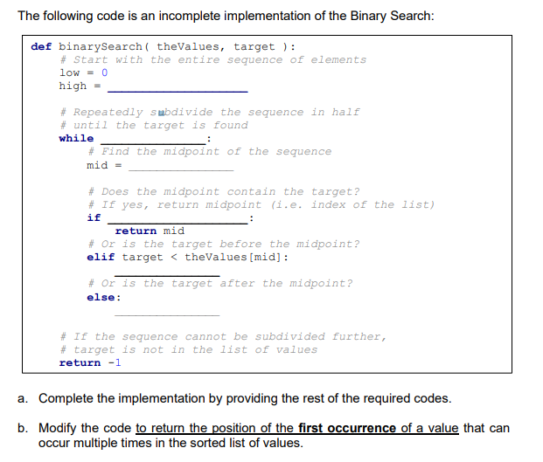
Search Algorithms: Binary Search

Slide 24
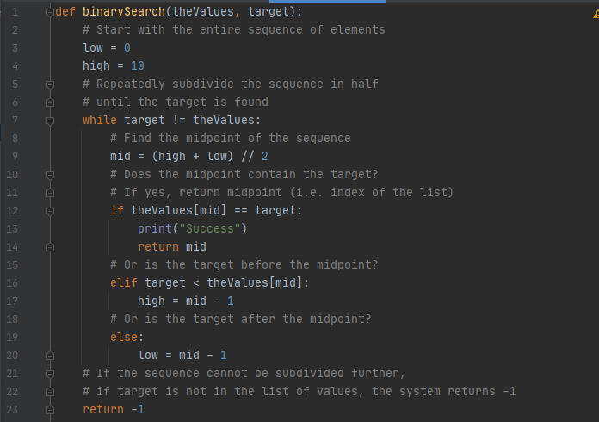
Search Algorithms: Binary Search

Slide 25

Thank you!!
Please fill in this feedback form so that we can improve our next event, see you next time :D
https://forms.gle/m6U2rFA58HVPuQK56
This is where you section ends. Duplicate this set of slides as many times you need to go over all your sections.
Notes:
https://forms.gle/m6U2rFA58HVPuQK56

